Slide 1
Data Science and Machine Learning
With R

Slide 2
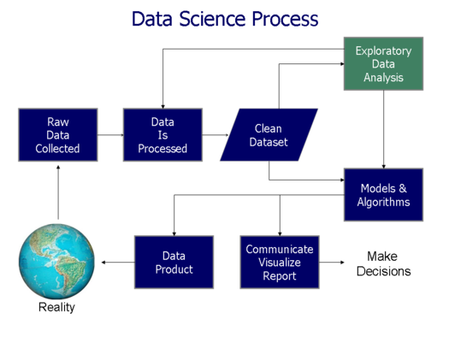

Slide 3
Process Followed
Frame the problem
Collect the raw data needed to solve the problem
Process the data (data wrangling)
Explore the data
Perform in-depth analysis (machine learning, statistical models, algorithms)
Communicate results of the analysis

Slide 4
Frame the problem

Slide 5
To analyse the prices of properties of two cities Sydney
and Melbourne

Slide 6
Collect the raw data needed to solve the problem

Slide 7
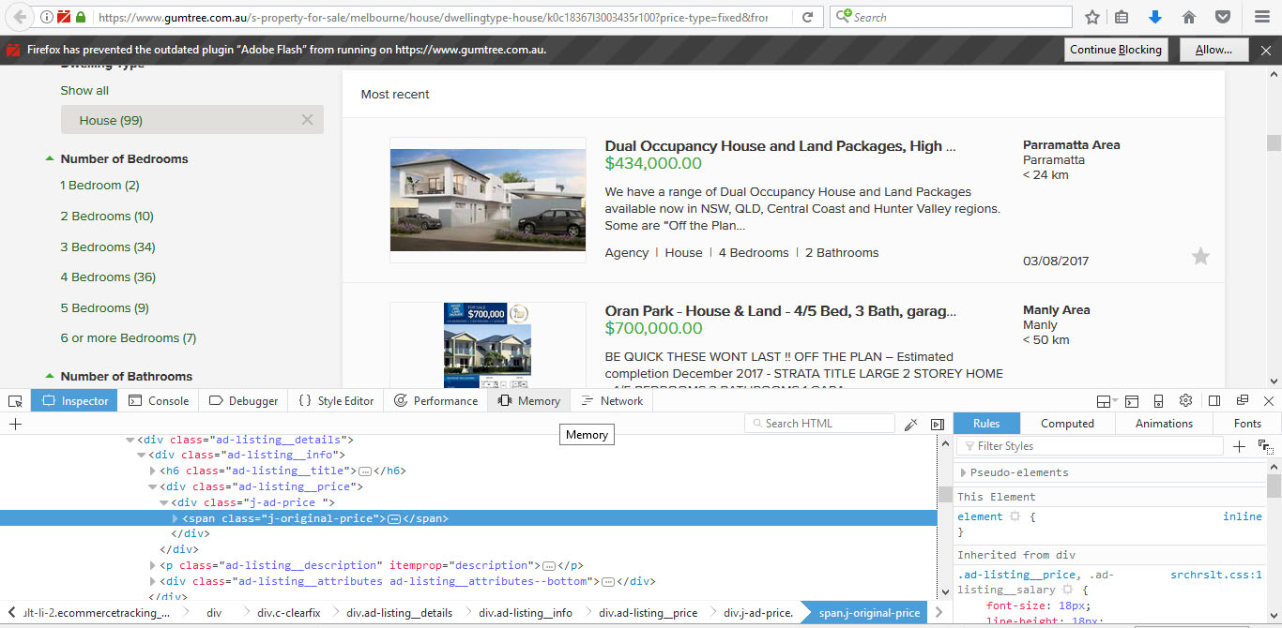

Slide 8
Process the data (data wrangling)

Slide 9
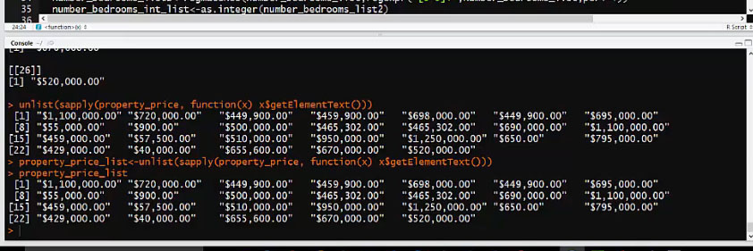

Slide 10
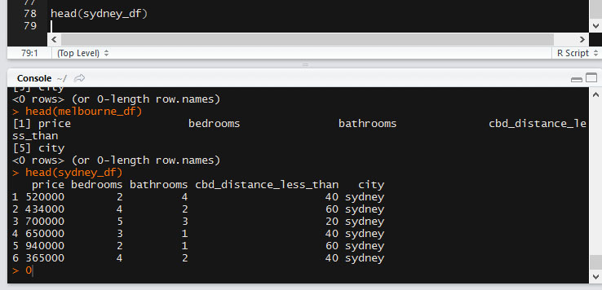

Slide 11
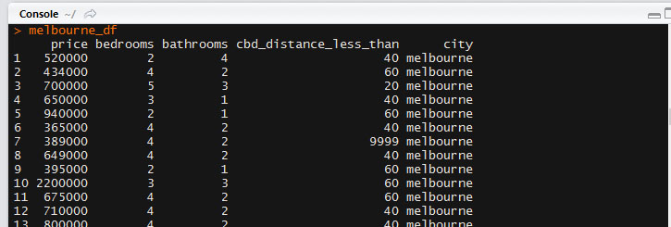

Slide 12
Explore the data

Slide 14
Perform in-depth analysis (machine learning, statistical models, algorithms)

Slide 15
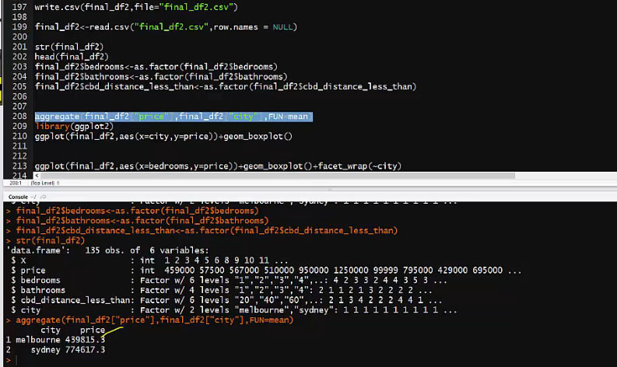

Slide 16
Communicate results of the analysis

Slide 17
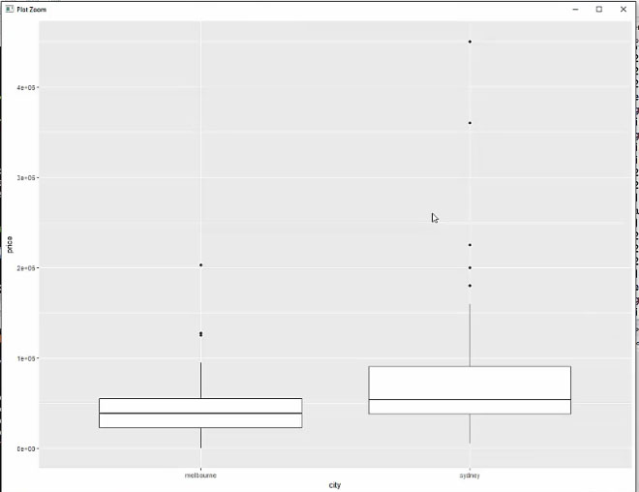

Slide 18
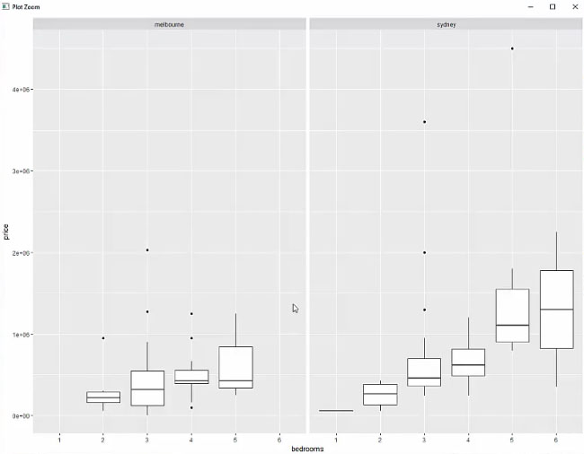

Slide 19
Thank You

